Slide 1

ZEROTH REVIEW
HANDWRITTEN TEXT RECOGNITION
Project Category: RESEARCH
SDG: QUALITY EDUCATION
Guide Name
DR.A Jackulin Maharibha
Assistant Professor
Department of Computational Intelligence
Student Name & Registration Number Pratham Handique &RA2111033010029 Burugu Ajith & RA2111033010050

Slide 2
INTRODUCTION
Handwritten text recognition (HTR) is a transformative technology that bridges the gap between analog and digital information by converting handwritten content into machine-readable formats. It plays a vital role in modernising processes across various fields, including education, digital archiving, and accessibility. This project focuses on developing an advanced system capable of recognising handwritten text, addressing the complexities of varying handwriting styles, low-quality images, and content written in multiple languages.
In education, it can automate grading and analysing handwritten work, saving time for teachers. In digital archiving, it helps preserve and make handwritten records, like historical documents and notes, searchable. HTR also improves accessibility by converting handwritten text into formats that assistive tools like screen readers can use. By solving the challenges of different handwriting styles and poor image quality, this project aims to create a reliable and impactful solution.

Slide 3
PROBLEM STATEMENT
Handwritten text recognition (HTR) involves converting handwritten content into digital formats, but it is a complex task due to the challenges of accurately processing diverse handwriting. Existing systems, such as Optical Character Recognition (OCR) tools, often struggle with handwritten text, resulting in frequent errors. The problem is further complicated when dealing with inconsistent handwriting styles, poor-quality images, and text in multiple languages. These limitations make it difficult to digitise handwritten content effectively.

Slide 4
CHALLENGES
1.People write in unique ways, including differences in slants, spacing, cursive, and block letters, making it hard to develop systems that can generalise across all styles.
2.Handwritten documents often have poor image quality due to issues like low resolution, uneven lighting, smudging, or faded ink, which makes accurate recognition even more difficult.
3.Some characters or numbers look similar in handwriting (e.g., lowercase 'l' and '1', uppercase 'O' and '0'), making it challenging to differentiate them accurately.
4.Physical defects like tears, stains, or writing over already printed material can obscure the text and reduce recognition accuracy.

Slide 5
OBJECTIVES
Our objective for the project are as follows:-
1.To train the “I am handwritten dataset” with a RNN model to accurately recognise and interpret handwritten text.
2.Use a Convolutional Neural Network (CNN) to extract spatial features from images and pass these features to the RNN for sequential processing.
3.Train models to adapt to various handwriting styles, including cursive, block letters, and unique individual styles.
4.Should be capable of understanding context, grammar, and semantics in handwritten text for improved text prediction or correction.
5.Identify individual characters, words, or lines within handwritten text for further processing.

Slide 6
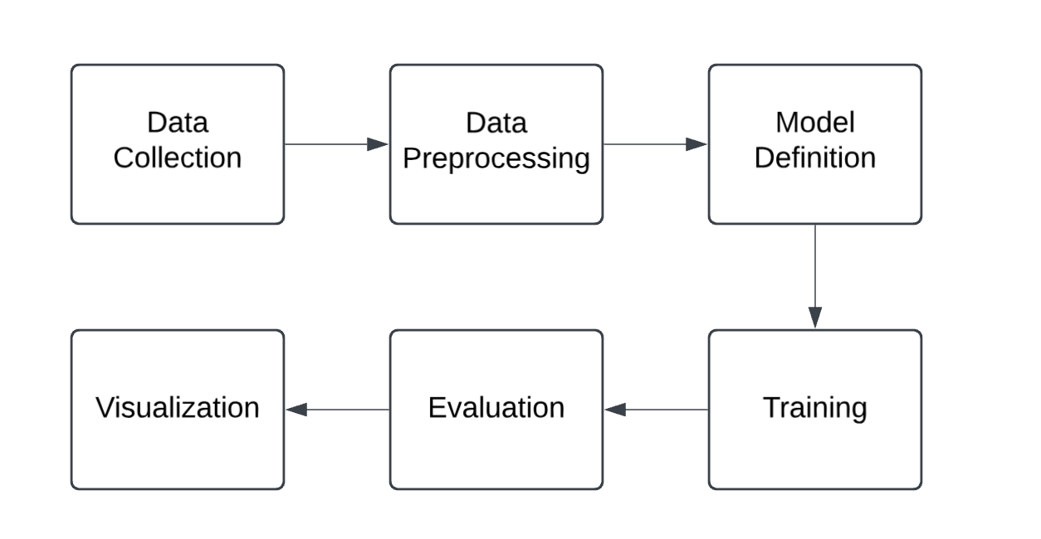
METHODOLOGY
Data Collection
Label: "Load IAM Handwritten Forms Dataset"
Description: Indicate the source of the dataset and
Data Preprocessing
Label: "Data Preprocessing"
Include steps like:
Resize and normalise images.
Convert images into sequential data
Perform augmentations if necessary.
Model Definition
Label: "Define RNN Model in PyTorch"
Specify:
Type of RNN (e.g., LSTM, GRU).
Input, hidden, and output sizes.
Number of layers and other hyperparameters.

Slide 7
METHODOLOGY
Training
Label: "Train the Model"
Steps:
Forward pass through the RNN.
Compute the loss using a suitable loss function (e.g., CTCLoss).
Back propagation to update weights using an optimiser (e.g., Adam or SGD).
Iterate over epochs.
Evaluation
Label: "Evaluate the Model"
Steps:
Test the model on validation or test data.
Compute accuracy, precision, recall, and other performance metrics.
Analyse results (e.g., edit distance for OCR tasks).
Visualisation
Label: "Visualise Metrics and Predictions"
Use:
Loss and accuracy curves to monitor training.
Display predictions versus ground truth.

Slide 8
TOOLS AND TECHNOLOGY
OCR Frameworks:
Use libraries like Tesseract OCR or EasyOCR for baseline text recognition tasks.
Deep Learning Frameworks:
Use TensorFlow or PyTorch to develop and train advanced models, such as Convolutional Neural Networks (CNNs) or Recurrent Neural Networks (RNNs) for handwritten text recognition.
Image Processing Libraries:
Use OpenCV or Pillow to preprocess images, including tasks like resizing, noise reduction, and binarization.
Data Management and Exploration Tools:
Use Pandas for managing dataset metadata and annotations, and Matplotlib/Seaborn for visualising data distribution.
Model Evaluation Libraries:
Use Scikit-learn for evaluating models through metrics like accuracy, precision, recall, and writer verification experiments.

Slide 9
DATA REQUIREMENTS
For data requirements we are using a dataset called “I am hand written forms dataset”.
About Dataset
Overview: The IAM Handwritten Forms Dataset contains forms of handwritten English text which can be used to train and test handwritten text recognisers and to perform writer identification and verification
Content: The dataset contains complete forms of unconstrained handwritten text, which were scanned at a resolution of 300dpi and saved as PNG images with 256 gray levels. Forms are partitioned into separate directories such that all forms in each directory are written by the same person.

Slide 10
EXPECTED OUTCOMES
The key outcomes of this project are as follows:-
1.Accurate Text Extraction from Handwriting.
2.Bridge the gap between training and test accuracy to avoid overfitting.
3.Detecting and recognising handwriting given in realtime.
4.A Research Paper where we want to publish our findings through a reputed journal.

Slide 11
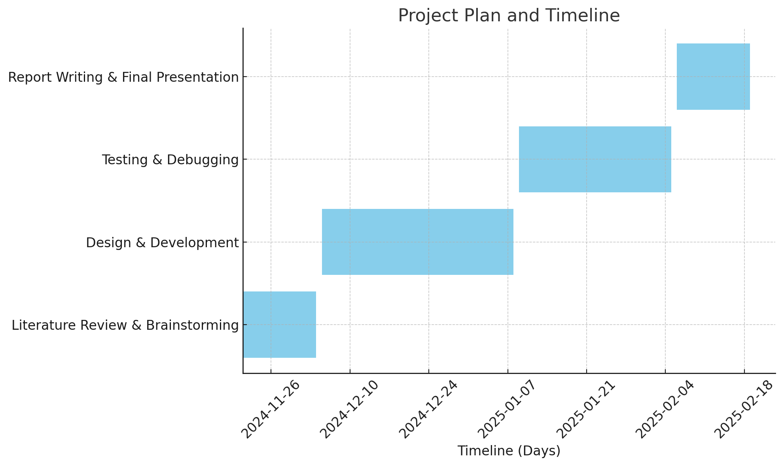
Project Planning and Timeline
Gantt Chart

Slide 12
ROLES AND RESPONSIBILITIES
Members |  | Tasks
Ajith | Dataset Study | Dataset Preprocessing | Study to find the appropriate model to perform the detection.
Pratham | Model Training | Model Evaluation | Model Feasibility
Ajith | Testing | Custom Data Training | Testing Study
Pratham | Model Optimization | Model Feasibility | Publishing

Slide 13
REFERENCES
[1]Bruno Simard , Birendra Prasada , On-line character recognition using handwriting modelling
https://doi.org/10.1016/0031-3203(93)90001-D
[2]Abhishek Bal, Rajib Saha ,An Improved Method for Handwritten Document Analysis Using Segmentation, Baseline Recognition and Writing Pressure Detection
https://doi.org/10.1016/j.procs.2016.07.227
[3]Hao Gao, Daji Ergu ,A robust cross-ethnic digital handwriting recognition method based on deep learning
https://doi.org/10.1016/j.procs.2022.01.093
[4]D. Prabha Devi a, R. Ramya a, P.S. Dinesh a, C. Palanisamy , Design and simulation of handwritten recognition system
https://doi.org/10.1016/j.matpr.2020.02.720
[5]Zhigang Peng a 1, Wandi Chen a 1, Jianpu Lin ,Input panel for handwriting detection based on turboelectric nano generator
https://doi.org/10.1016/j.cej.2024.156717
[6]Amani Ali Ahmed Ali a b, Suresha Mallaiah ,Intelligent handwritten recognition using hybrid CNN architectures based-SVM classifier with dropout
https://doi.org/10.1016/j.jksuci.2021.01.012
[7]IOANNIS PAVLIDIS , RAHUL SINGH ,ON-LINE HANDWRITING RECOGNITION USING PHYSICS-BASED SHAPE METAMORPHOSIS
https://doi.org/10.1016/S0031-3203(98)00018-1

Slide 14
[8]Supriya Mahadevkar a, Shruti Patil b, Ketan Kotecha ,Enhancement of handwritten text recognition using AI-based hybrid approach
https://doi.org/10.1016/j.mex.2024.102654
[9]R. Legault, C. Nadal,M. Cheriet, L. Lam , Building a new generation of handwriting recognition systems
https://doi.org/10.1016/0167-8655(93)90096-V
[10]Vanita Agrawal a, Jayant Jagtap b, M.V.V. Prasad Kantipudi
Exploration of advancements in handwritten document recognition techniques
https://doi.org/10.1016/j.iswa.2024.200358
[11]Mayur Bhargav Bora, Dinthisrang Daimary, Khwairakpam Amitab, Handwritten Character Recognition from Images using CNN-ECOC
https://doi.org/10.1016/j.procs.2020.03.293
[12]D. Prabha Devi ,R. Ramya ,P.S. Dinesh ,C. Palanisamy, Design and simulation of handwritten recognition system
https://doi.org/10.1016/j.matpr.2020.02.720
[13]Siddiqui Mohammad Khaja Moinuddin, Suneet KumarAnalysis and simulation of handwrittenRecognition system.
https://doi.org/10.1016/j.matpr.2021.05.021
[14]Adnan Amin , Off-line Arabic character recognition: the state of the art
https://doi.org/10.1016/S0031-3203(97)00084-8
[15]M. Karthi ,R. Priscilla ,K. Syed Jaffer ,A Novel Content Detection Approach for Handwritten English letters
https://doi.org/10.1016/j.procs.2020.05.149

